Slide 1
Clinical Trial Information Extraction with BERT
Xiong Liu · Greg L. Hersch · Iya Khalil · Murthy Devarakonda
Presented by: Likitha chowdary chereddy

Slide 2
Paper at glance
AUTHORS
Xiong Liu, Greg L. Hersch, Iya Khalil, Murthy Devarakonda
Venue & Year of the Paper
IEEE International Conference on Healthcare Informatics (ICHI) - 2021
https://doi.org/10.1109/ICHI52183.2021.00092
Clinical Trial Information Extraction using CT-BERT

Slide 3
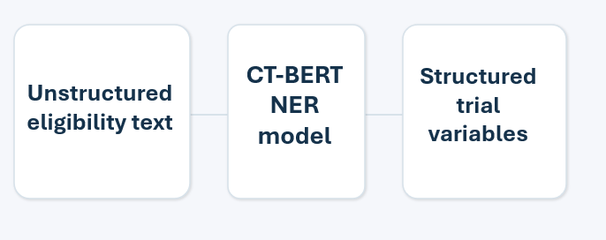
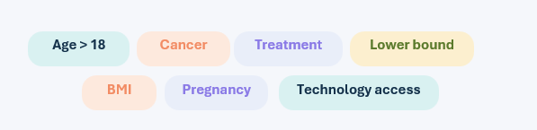
PAPER TOPIC AND OVERVIEW
Clinical trials contain unstructured eligibility text
Manual and difficult to extract
Need structured data for:
Trial design
Patient matching
AI analysis
CT-BERT (BERT-based NER model)
Goal: Free text → structured clinical variables
Why this matters
Better extraction can support new trial design, screening logic, and downstream AI systems built on structured trial criteria.

Slide 4
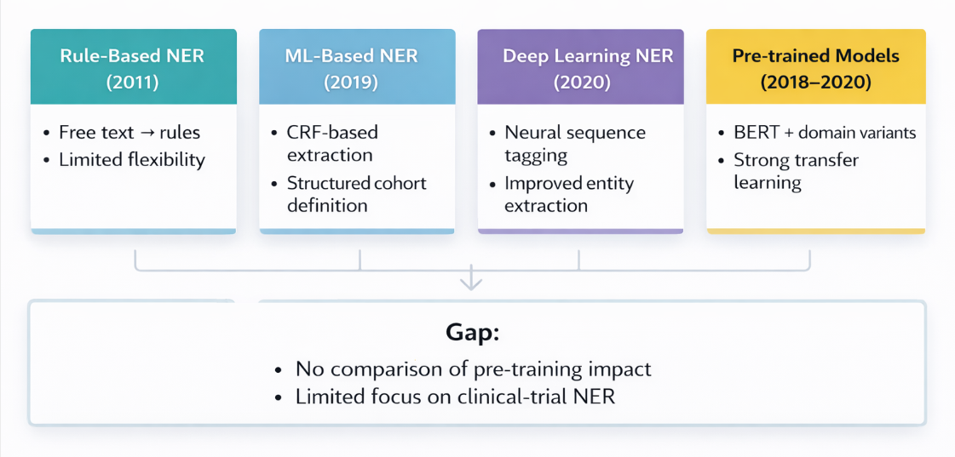
PRIOR WORK

Slide 5
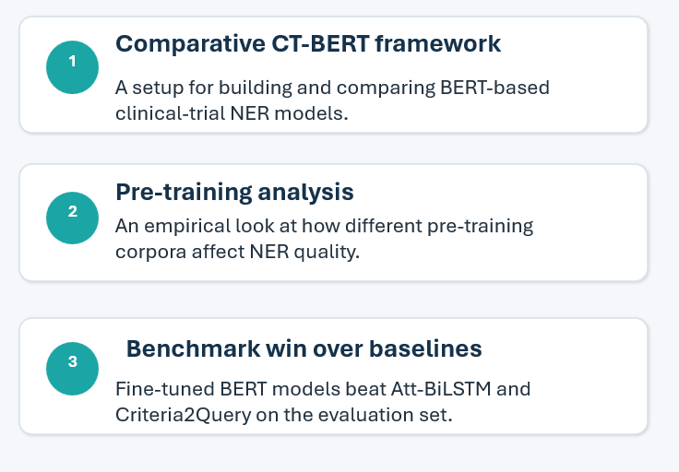
Thesis & Contributions
"BERT-based NER models fine-tuned on ClinicalTrials.gov data outperform prior baselines in clinical trial information extraction, paving the way for AI-driven clinical trial design."

Slide 6
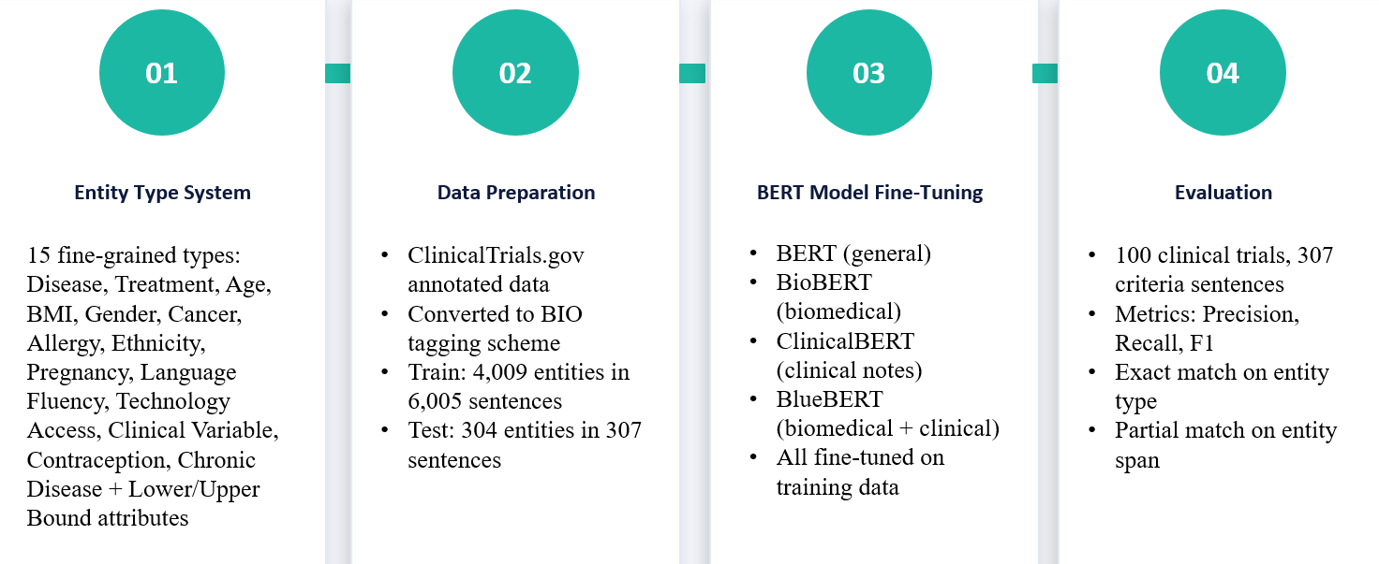
METHODOLOGY: CT-BERT APPROACH

Slide 7
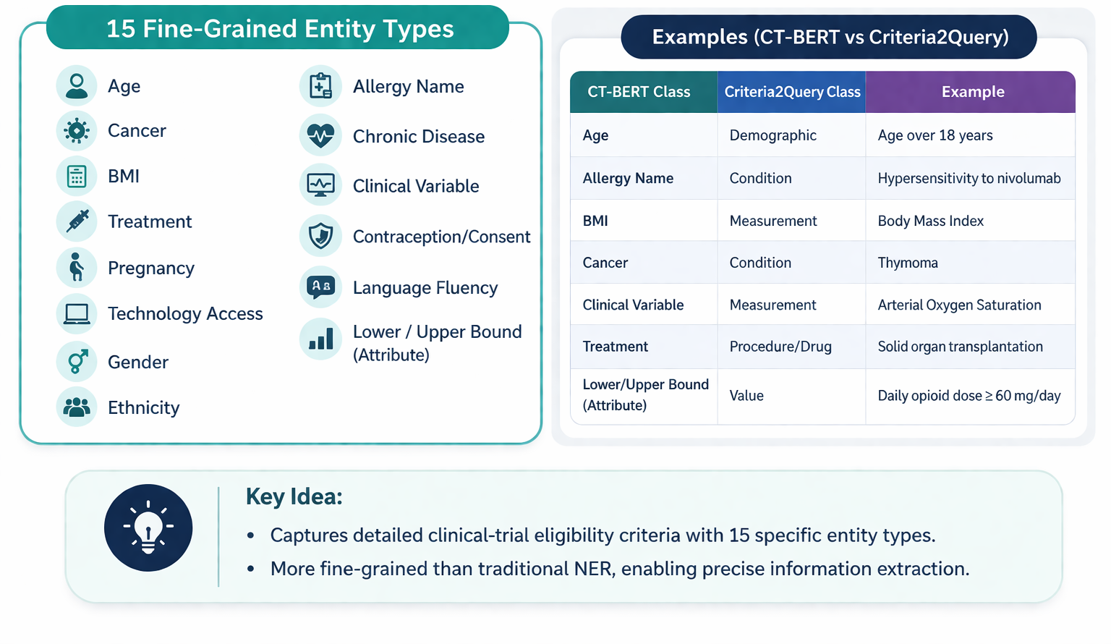
CT-BERT ENTITY TYPE SYSTEM

Slide 8
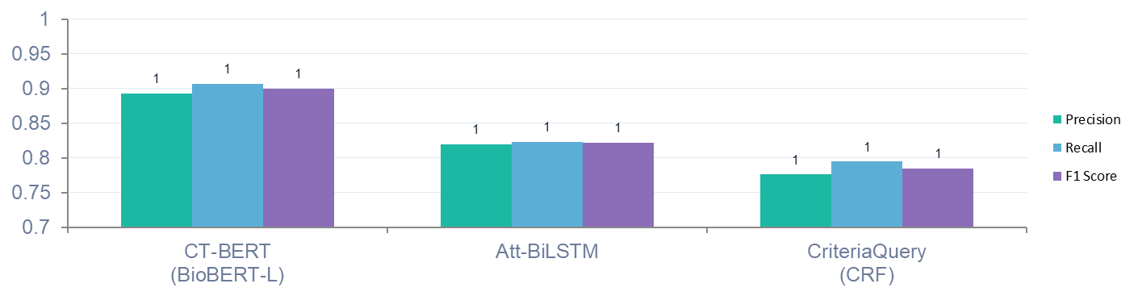
Results from the approach
Model Performance Comparison
Key Observations
CT-BERT achieves highest performance
F1 Score: 0.844 (best)
Att-BiLSTM: 0.802
Criteria2Query: 0.804
Interpretation
BERT-based models outperform traditional methods
Domain-specific pre-training improves results
Conclusion from Results
CT-BERT is more effective for clinical-trial NER
BioBERT pre-training contributes to better performance

Slide 9
Conclusion of the paper
Main Findings
CT-BERT improves clinical-trial NER performance
Achieves highest F1 score (0.844)
Outperforms Att-BiLSTM and Criteria2Query
Key Takeaways
BERT-based models are effective for NER tasks
Domain-specific pre-training (BioBERT) improves results
Fine-grained entity types enhance information extraction
Overall Impact
Enables better extraction of clinical trial eligibility criteria
Supports AI-driven clinical trial analysis and design

Slide 10
CRITICAL ANALYSIS: DO RESULTS JUSTIFY CONCLUSIONS?
METHODOLOGY STRENGTHS
Publicly available benchmark: Used same evaluation set as baselines -fair comparison Consistent evaluation metrics: Exact entity-type + partial span matching - same as Att-BiLSTM and Criteria2Query Multiple BERT variants tested: 4 models across domain spectrum - provides empirical grounding Meaningful improvement:
LIMITATIONS & CONCERNS
Small test set: Only 307 criteria sentences — statistical significance of differences unclear No statistical significance tests: No p-values or confidence intervals reported — gains may be unstable Relation extraction deferred: Attribute-entity linking (lower/upper bound) left for extended version Single-domain generalizability: Tested only on ClinicalTrials.gov — cross-registry performance unknown
~4% higher F1 than Att-BiLSTM
CT-BERT: 0.844 vs 0.802

Slide 11
FUTURE WORK & OPEN DIRECTIONS
Paper-Implied Work
Extend to relation extraction
Link attributes to base entities
Recommended Improvements
Use larger and more diverse datasets
Add statistical significance analysis
Perform detailed error analysis
Next Direction
Build end-to-end clinical trial systems
Combine NER + relation extraction + applications

Slide 12
References
Liu, X., Hersch, G. L., Khalil, I., & Devarakonda, M. (2021). Clinical trial information extraction with BERT. Proceedings of the IEEE 9th International Conference on Healthcare Informatics (ICHI). https://doi.org/10.1109/ICHI52183.2021.00092

Slide 13

Thank you Questions & discussion
LIKITHA CHOWDARY CHEREDDY| lchereddy@rivier.edu

